Slide 1

Machine Learning-Based Rainfall Prediction: Unveiling Insights and Forecasting for Improved Preparedness
Guide:
Dr. Venkatesan R
Assistant Professor III
SoC
Reg No./Students: 126158027 – KRISHLAYA KUMAR

Slide 2

Table Of Contents
• Motivation
• Objective
• Base Paper
• Problem Statement
• Literature survey
• Modules
• Dataset
• References
17-02-2025
2

Slide 3
MOTIVATION
• Rainfall prediction is essential for disaster management, agriculture, and urban planning.
01
• Traditional methods struggle with accuracy due to the complex nature of rainfall patterns.
02
• Machine learning provides a data-driven approach to enhance prediction accuracy.
03

Slide 4
OBJECTIVE
Develop a machine learning model for rainfall prediction using historical weather data.
Apply feature selection techniques to improve prediction accuracy.
Compare multiple machine learning algorithms to find the best-performing model.

Slide 5
Base Paper
Title: Machine Learning-Based Rainfall Prediction
Authors: Md. Mehedi Hassan , Md. Asif Rakib Khan, Farhana Yasmin, Anindya Nag, Tazria Helal Zarin, Anupam Kumarbairagi, Samah Alshathri ,ANDWALIDEL SHAFAI
Published in: IEEE ACCESS, 2023
Focus: Implementation of various ML models for rainfall forecasting using Australian weather data.
https://ieeexplore.ieee.org/document/10320349
5

Slide 6
Problem Statement
Rainfall is influenced by multiple factors like temperature, humidity, pressure, and wind speed.
Traditional forecasting methods lack accuracy and adaptability.
Need for an efficient machine learning-based system to predict rainfall more accurately.

Slide 7
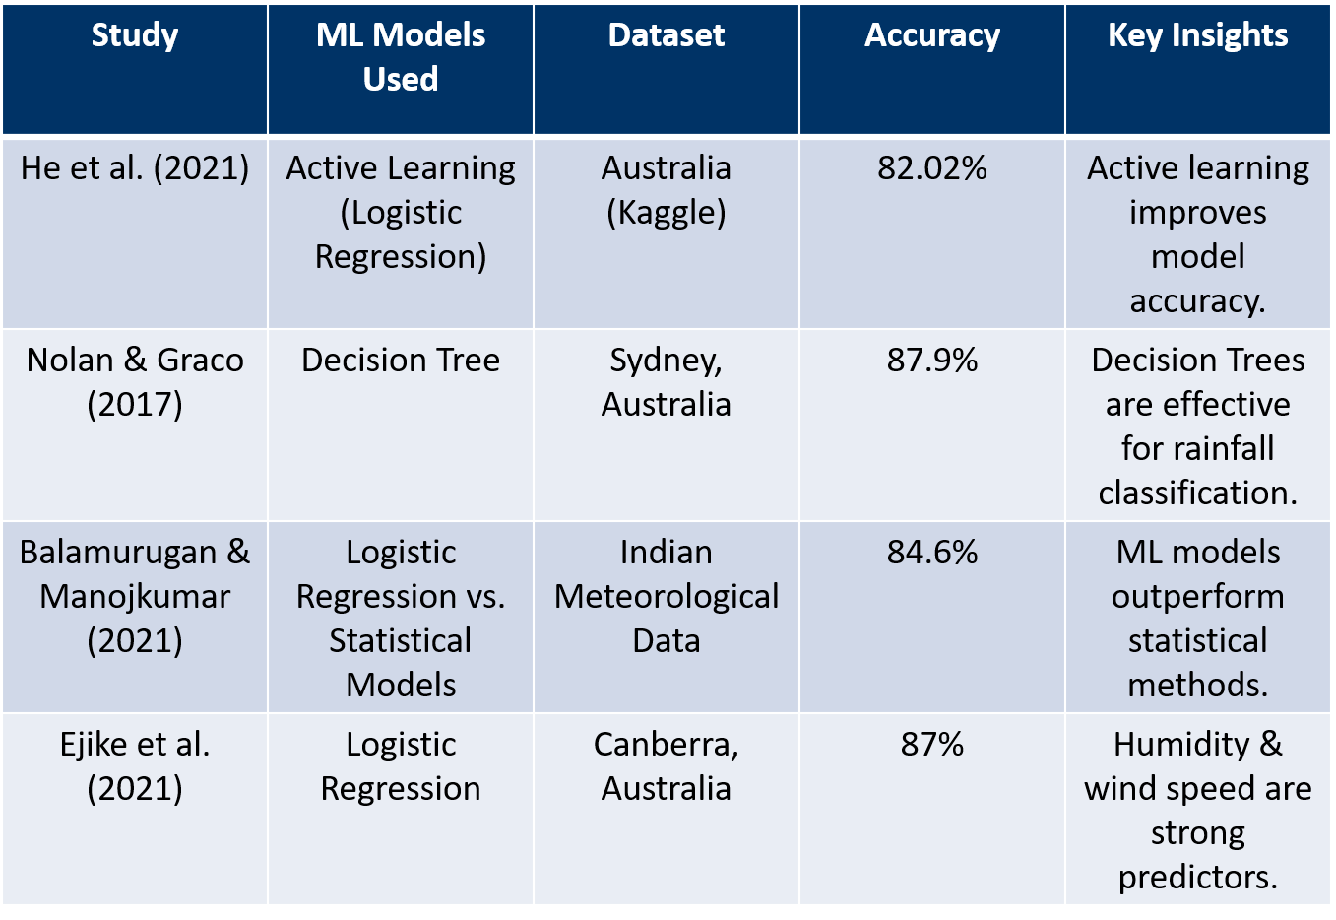
LITERATURE SURVEY

Slide 8
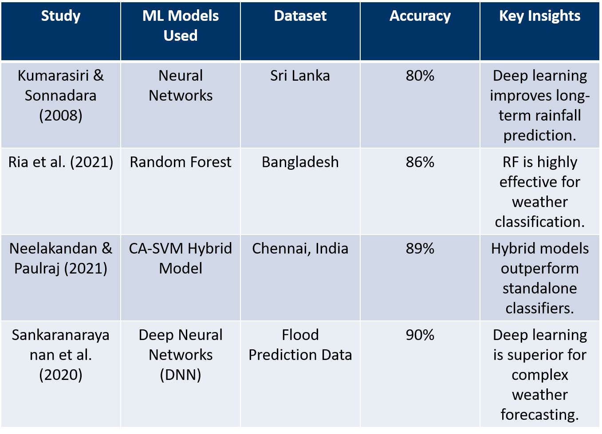
LITERATURE SURVEY

Slide 9
MODULES
Data Preprocessing
Handling Missing Values - Encoding Categorical Data - Outlier Detection & Removal - Normalization & Scaling
Feature Selection
Correlation Analysis - Principal Component Analysis (PCA) - Feature Importance (Decision Tree-Based Ranking)
Machine Learning Models Used for Prediction
Naïve Bayes (NB) - Decision Tree (DT) - Support Vector Machine (SVM) - Random Forest (RF) - Logistic Regression (LR) - Artificial Neural Network (ANN)
Clustering & Pattern Analysis
K-Means Clustering- PCA-Based Clustering
Model Performance Evaluation
Confusion Matrix - Precision, Recall, F1-Score - ROC Curve Analysis
Web-Based Rainfall Prediction System

Slide 10
WORKFLOW
Data Collection
Data Preprocessing
Feature Selection
Machine Learning Models
Model Evaluation
Deployment

Slide 11
DATA SET
• Source: Australian Bureau of Meteorology (10 years of data).
• Observations: 145,460 records from 49 weather stations.
• Features: 24 attributes, including temperature, humidity, pressure, wind speed, etc.
• Target Variable: Rain Tomorrow (Yes/No).

Slide 12
Data Preprocessing
Data Cleaning and Visualization Overview :-
In the initial phase of our mini project, we focused on refining the dataset through meticulous data cleaning and visualization techniques. Our objective was to enhance the quality and coherence of the data, making it more suitable for subsequent analysis. This section encapsulates our methodology and key steps in achieving a refined dataset.
Data Cleaning :- Our data cleaning process comprised handling missing values, encoding categorical features, and ensuring data integrity. Notably, we employed strategic approaches to replace null values, fostering a more complete and robust dataset. Categorical features were encoded to numerical values, facilitating machine learning model compatibility.
Visualization :-Visualization played a pivotal role in understanding the characteristics of the data and identifying patterns. Through well-crafted plots and graphs, we delved into the distribution of features, relationships between variables, and the impact of categorical features on our target variable.

Slide 13
Key Steps:
Handling Null Values: Robust techniques were employed to replace missing values, ensuring data completeness and reliability.
Categorical Feature Encoding: Transformation of categorical features into numerical representations for seamless integration into machine learning models.
Strategic Plotting: Visualization techniques such as histograms, scatter plots, and bar graphs were leveraged to gain insights into the distribution and relationships within the dataset.

Slide 14

various types of features:-
numerical_feature :-which contains the column names of the DataFrame df where the data type is not 'O' (i.e., not an object or a string). This list includes features that are numeric in nature, such as integers or floats. There are total of 17 `numerical_feature`
discrete_feature :-which includes the features from `numerical_feature` but only those where the number of unique values is less than 25. This suggests that these features are likely to be discrete rather than continuous, as they have a relatively small number of distinct values. There are total of 2 `discrete_feature`.
continuous_feature:-list is created by taking the elements from `numerical_feature` that are not present in the discrete_feature list. These are the numerical features that are not considered discrete, implying they may have a larger range of values and are likely continuous. There are total of 15 `continuous_feature`.
categorical_feature :-list is created by taking the columns from the DataFrame df that are not in the `numerical_feature` list. These are likely features with non-numeric data types (e.g., strings or objects), suggesting they are categorical in nature. There are total of 7 `categorical_feature`.

Slide 15
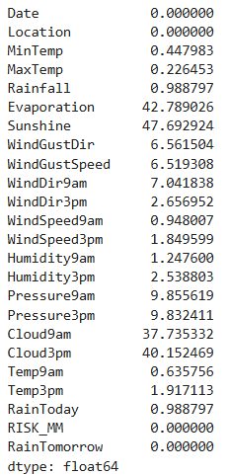
Examining the percentage of null values:-

Slide 16
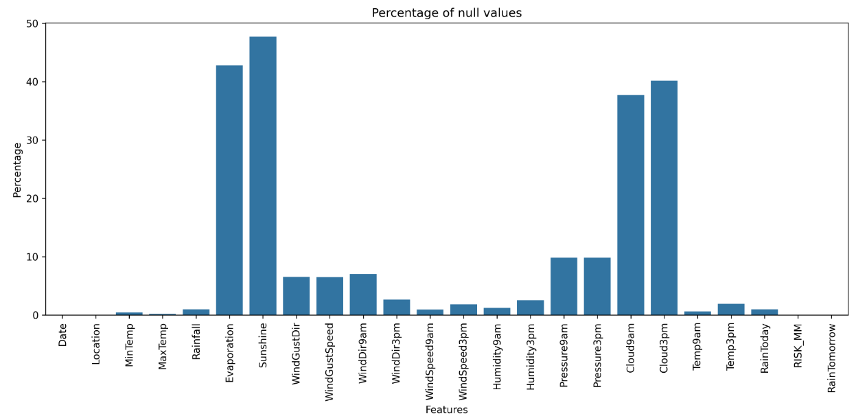
barplot for the column vs percentage of null values

Slide 17
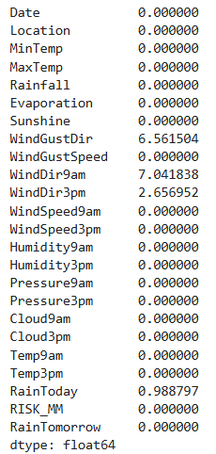
Random Sample Imputation for Missing Data:-
numerical_feature:-
['MinTemp', 'MaxTemp', 'Rainfall', 'Evaporation', 'Sunshine', 'WindGustSpeed', 'WindSpeed9am', 'WindSpeed3pm’,
'Humidity9am', 'Humidity3pm', 'Pressure9am', 'Pressure3pm', 'Cloud9am', 'Cloud3pm', 'Temp9am', 'Temp3pm’,
'RISK_MM']

Slide 18
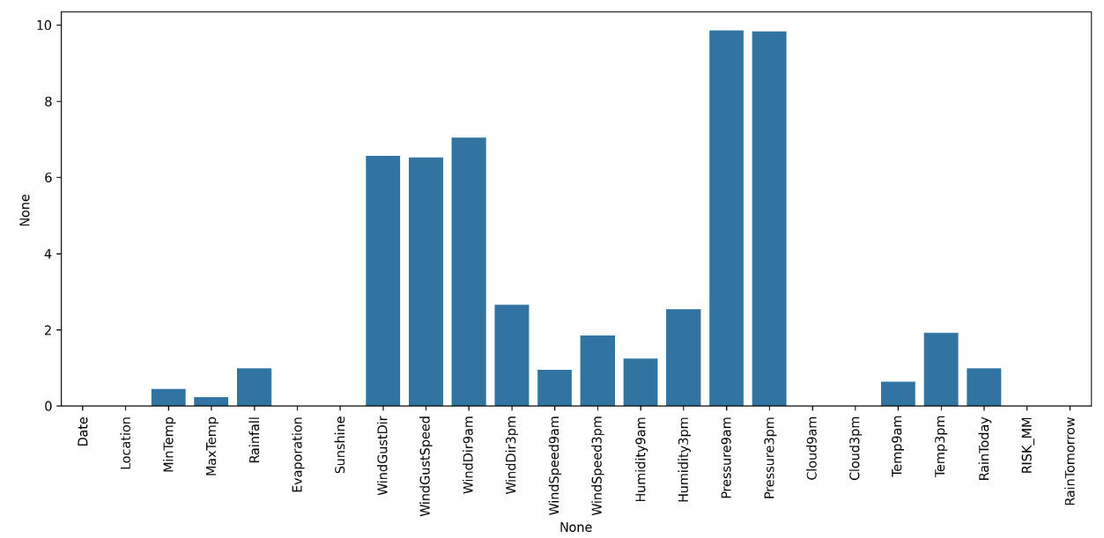

Slide 19
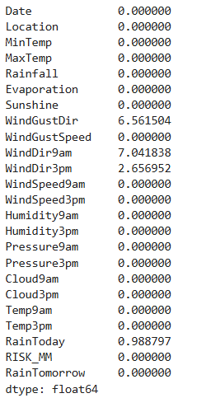
continuous_feature:-
['MinTemp', 'MaxTemp', 'Rainfall', 'Evaporation', 'Sunshine', 'WindSpeed9am', 'WindSpeed3pm’,
'Humidity9am', 'Humidity3pm', 'Pressure9am', 'Pressure3pm', 'Cloud9am', 'Cloud3pm', 'Temp9am', 'Temp3pm’,]

Slide 20
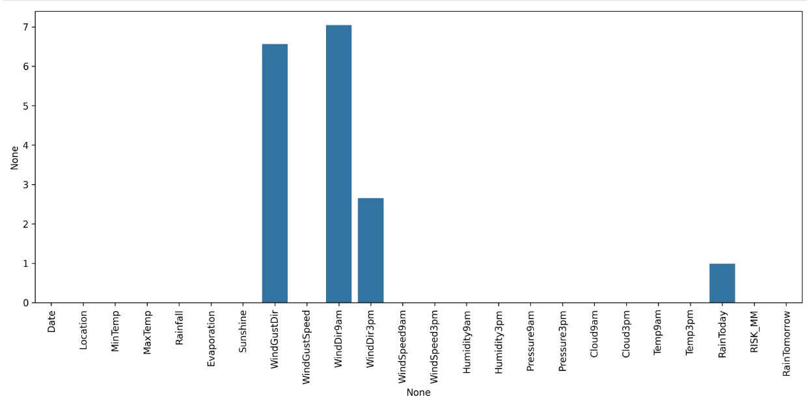
bar graph after removing the column with the maximum null values:

Slide 21
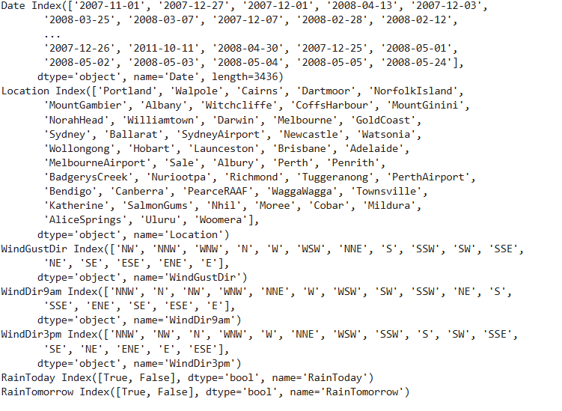
We've handled the null values numeric features now we'll proceed to deal with catagorical features, we will even encode the catagorical data along with this process

Slide 22
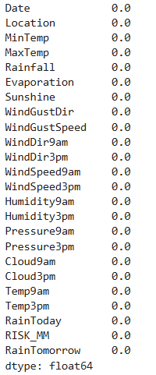
Removing all the null value

Slide 23
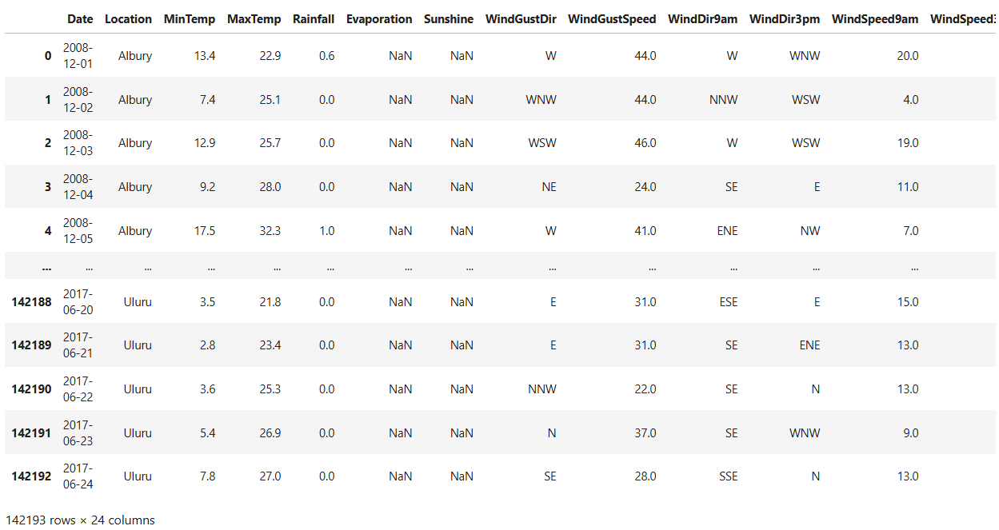
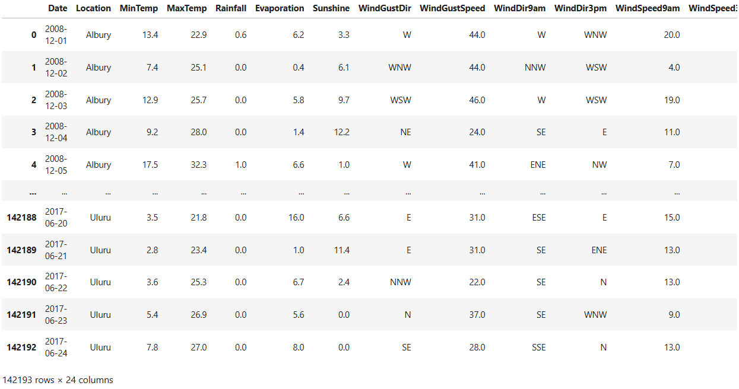
compare the dataset before and after removing Null value:-

Slide 24
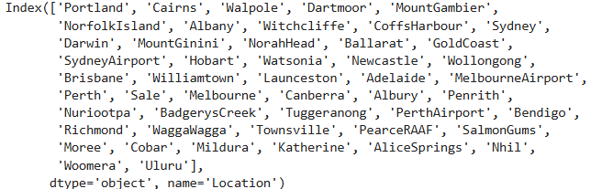
sort the values to see where it rained the most:-

Slide 25
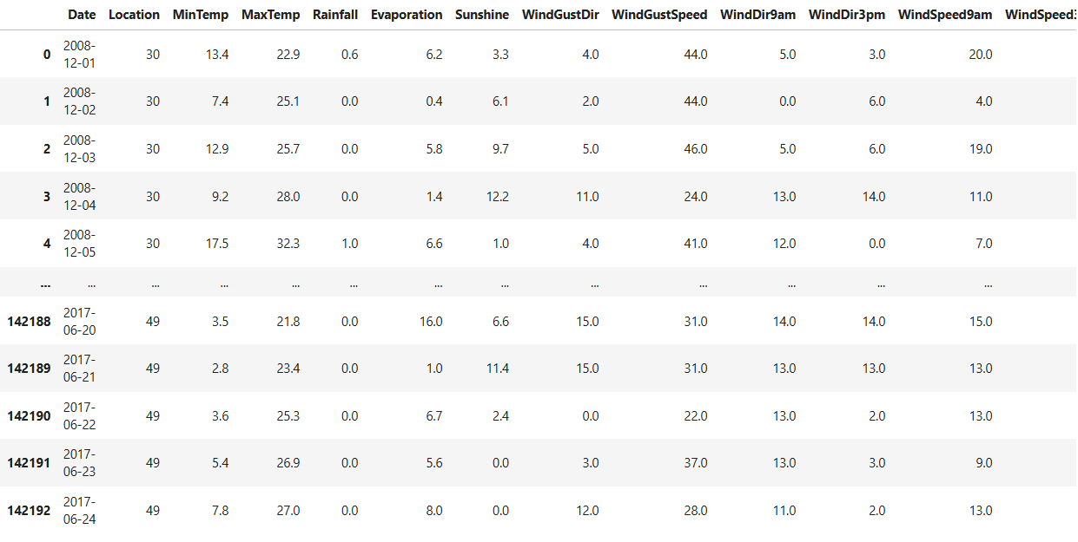
Convert this into new csv file:-
preprocessed_with_outliers.csv

Slide 26
calculates the Interquartile Range (IQR) and determines the lower and upper bounds for detecting outliers:-
continuous_feature | lower_bridge | upper_bridge
MinTemp | -6.200000000000001 | 30.6
MaxTemp | 2.4499999999999975 | 43.65
Rainfall.quantile | -0.8999999999999999 | 1.5
Evaporation.quantile | -4.600000000000001 | 14.600000000000001
WindGustSpeed.quantile | 8.5 | 68.5
WindSpeed9am.quantile | -11.0 | 37.0
WindSpeed3pm.quantile | -3.5 | 40.5
Humidity9am.quantile | 18.0 | 122.0
Pressure9am.quantile | 1001.0500000000001 | 1034.25
Pressure3pm.quantile | 998.4000000000001 | 1032.0
Temp9am.quantile | -1.4999999999999982 | 35.3
Temp3pm.quantile | 2.299999999999997 | 40.7

Slide 27
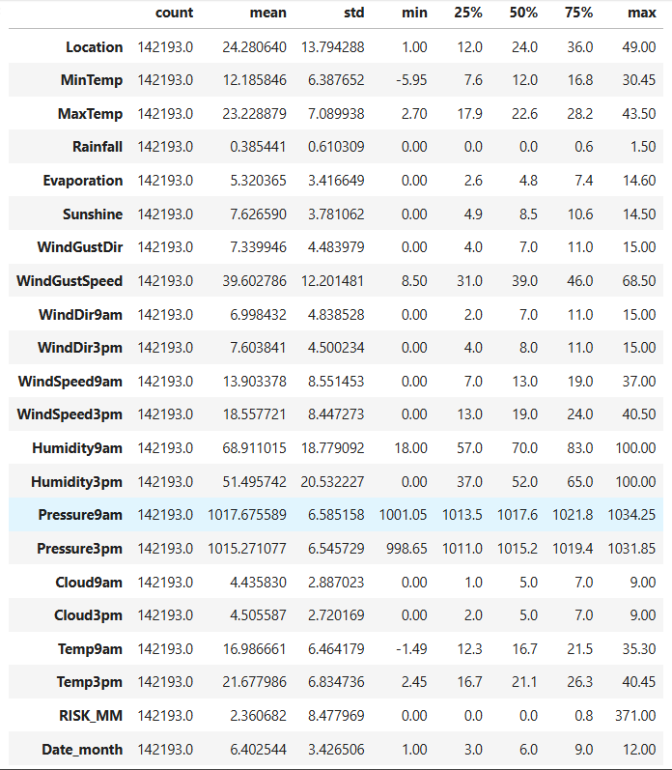
Data Visualization:-

Slide 28
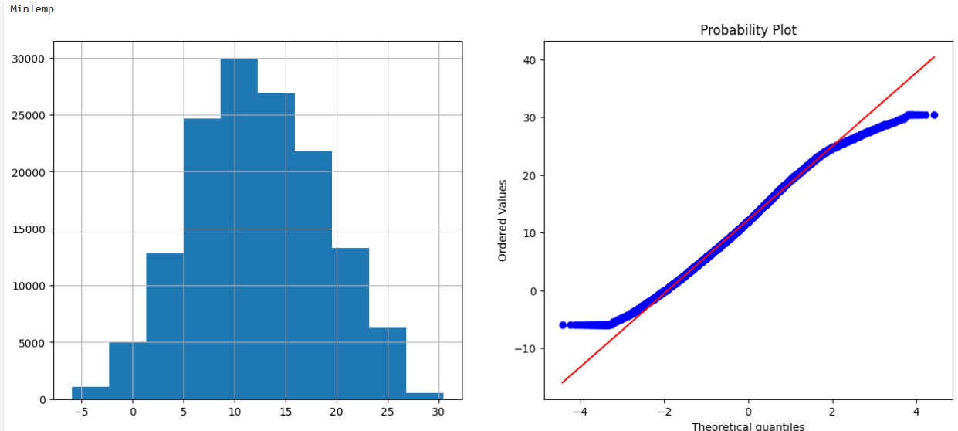

Slide 29
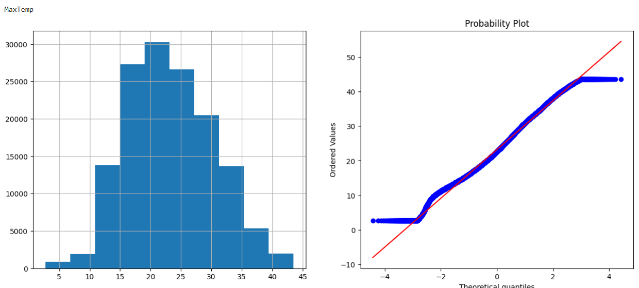

Slide 30
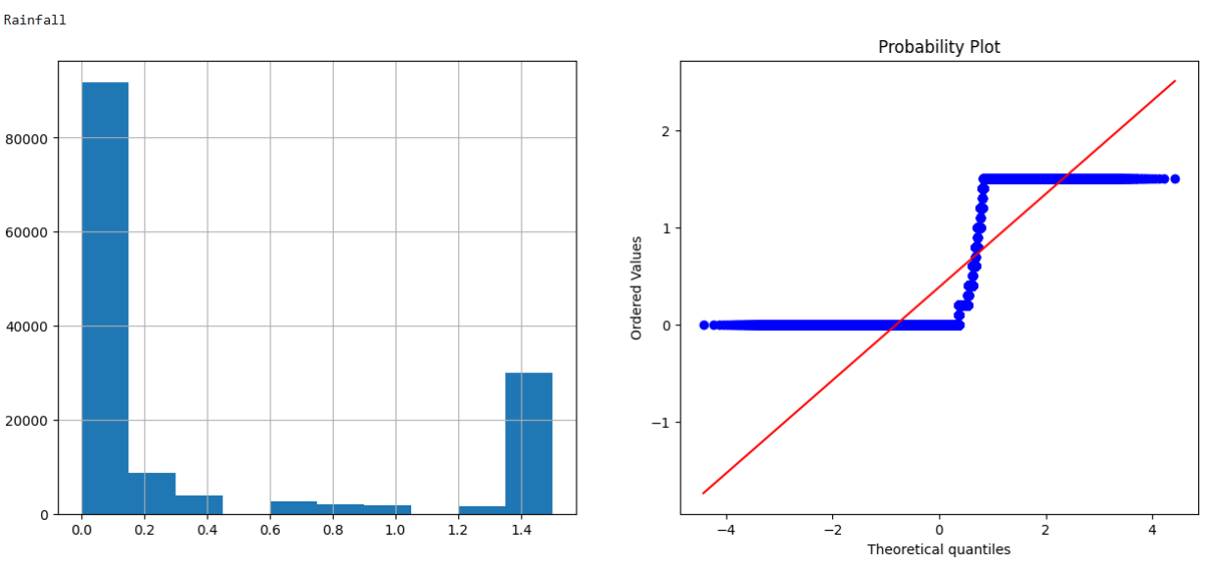

Slide 31
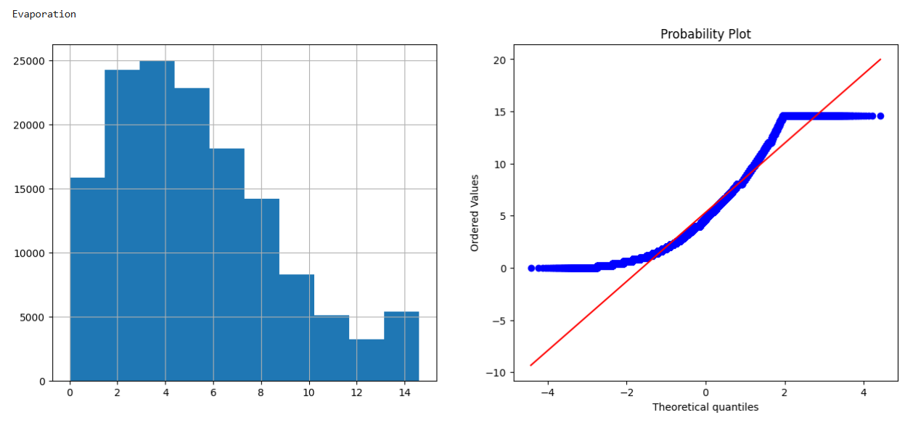

Slide 32
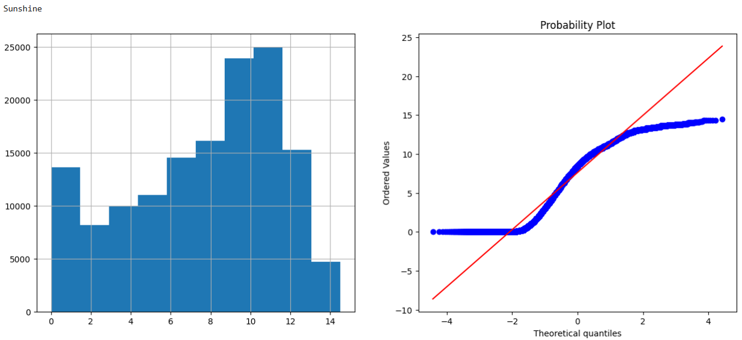

Slide 33
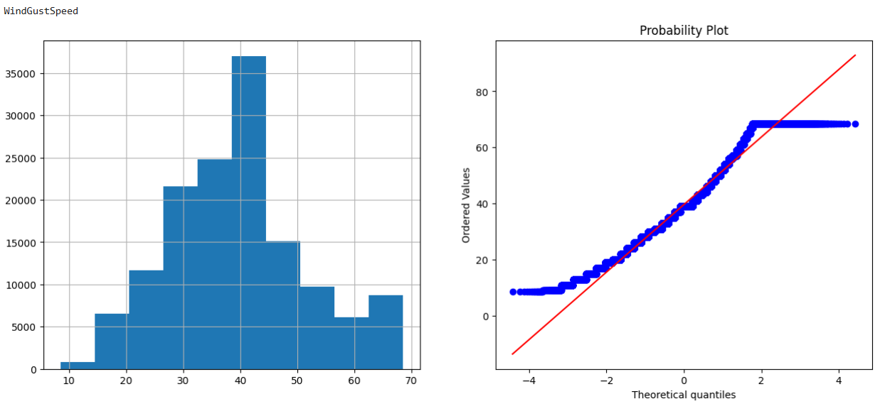

Slide 34
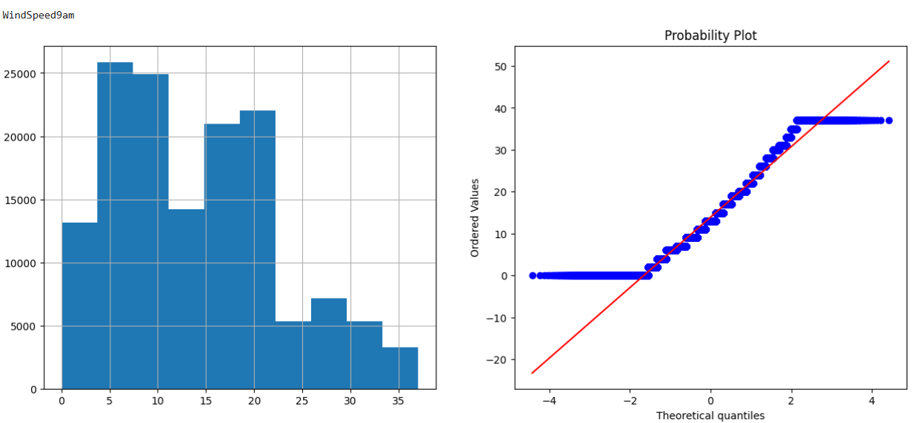

Slide 35
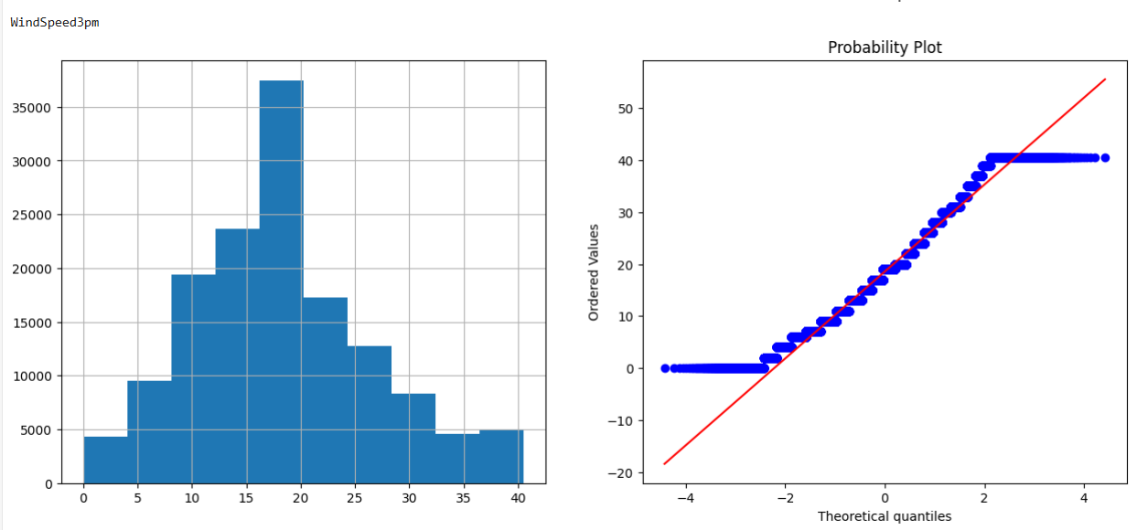

Slide 36
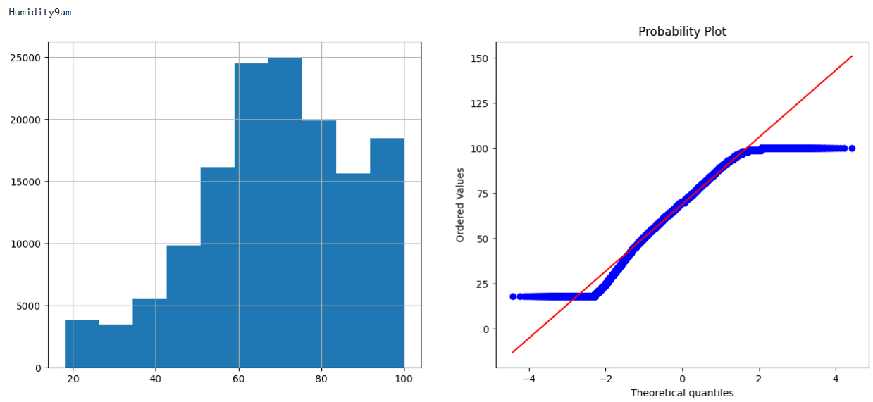

Slide 37
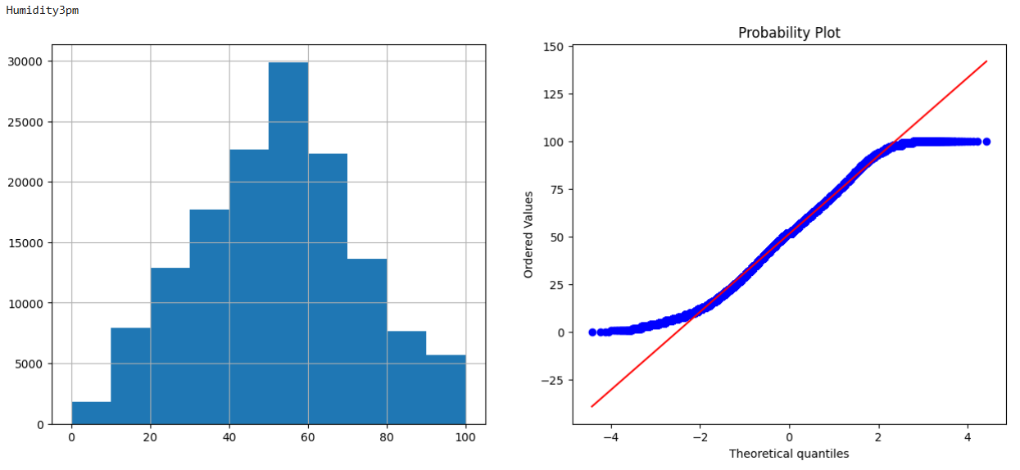

Slide 38
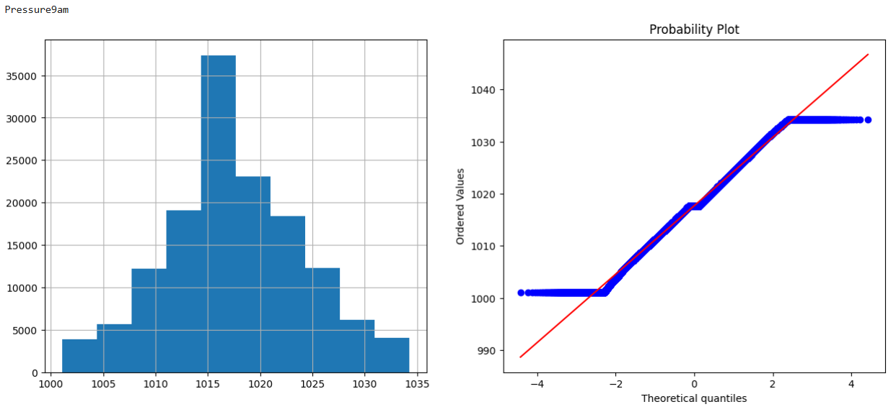

Slide 39


Slide 40
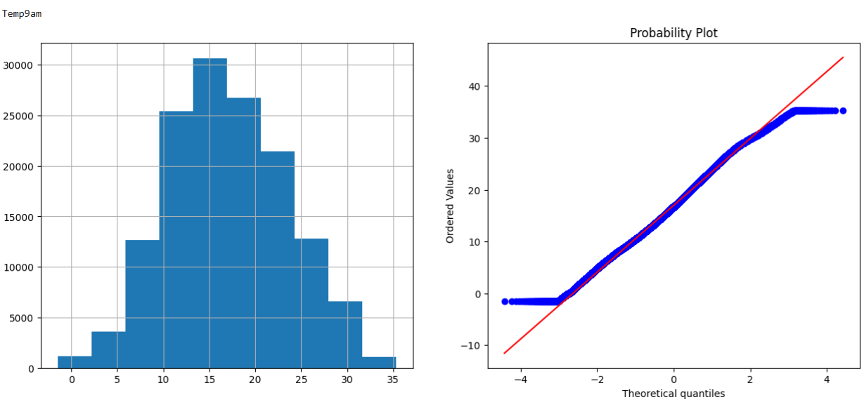

Slide 41
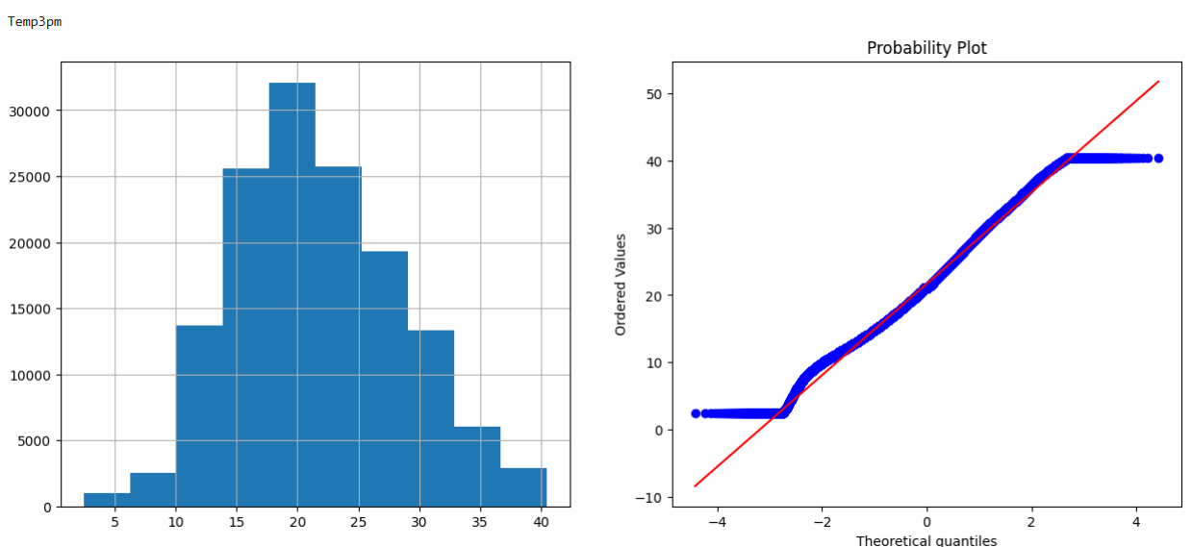

Slide 42
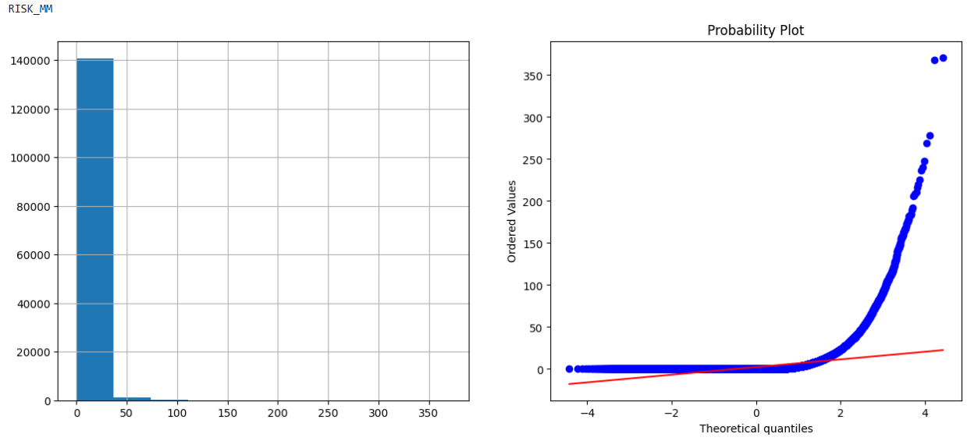

Slide 43
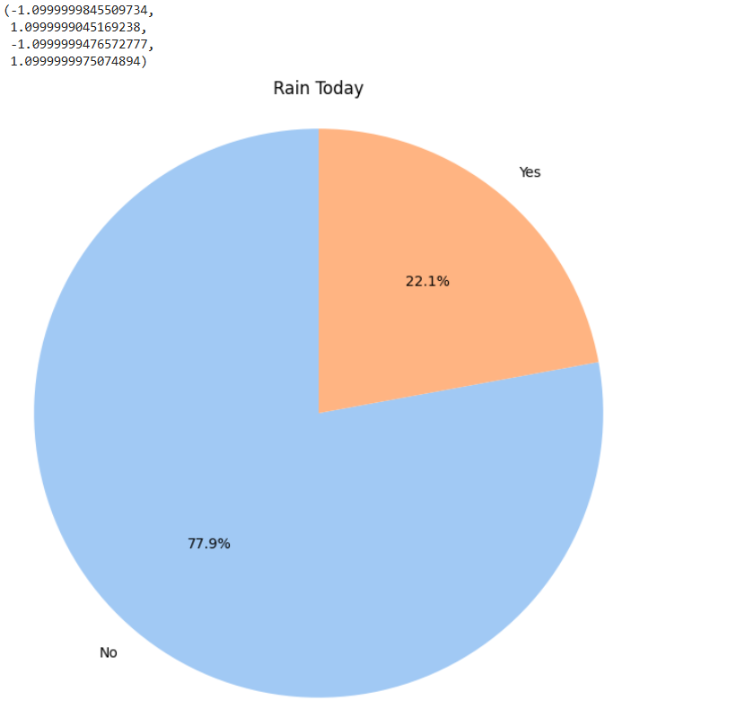

Slide 44
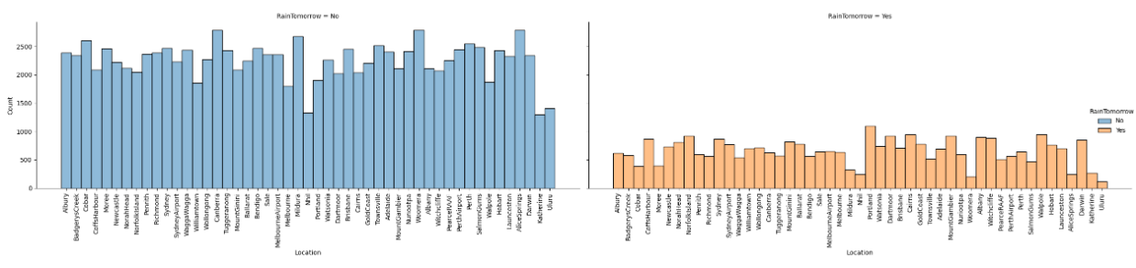
Bar Graph showing the count of Rain tomorrow:-

Slide 45
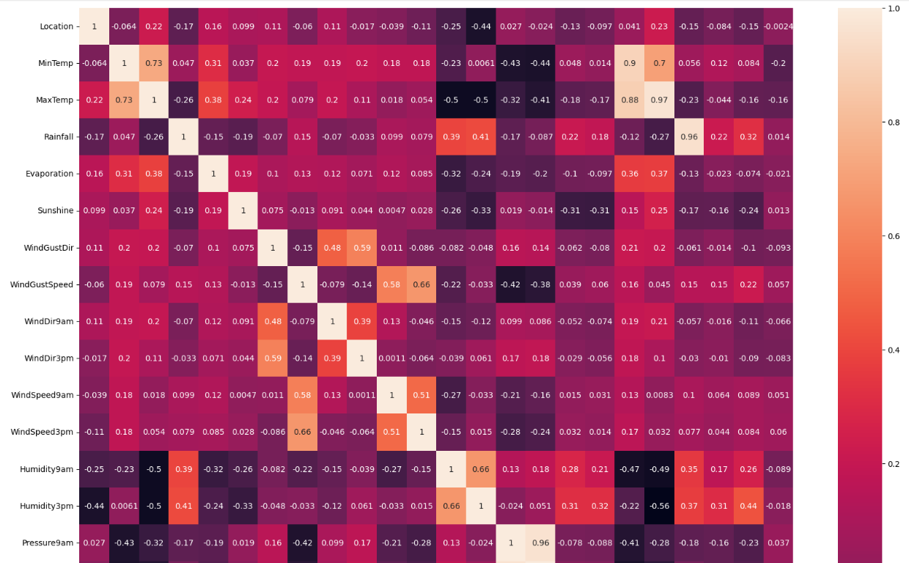
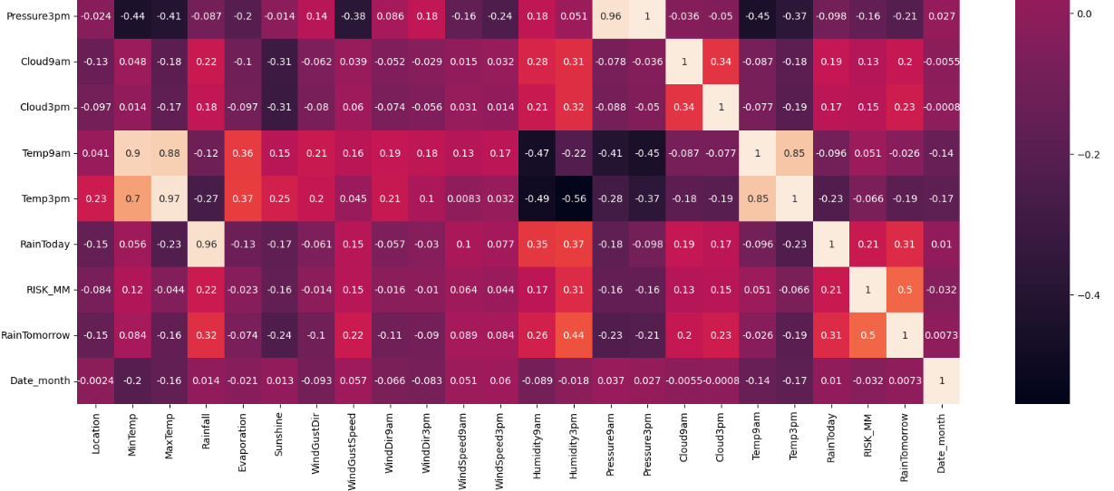
heatmap

Slide 46
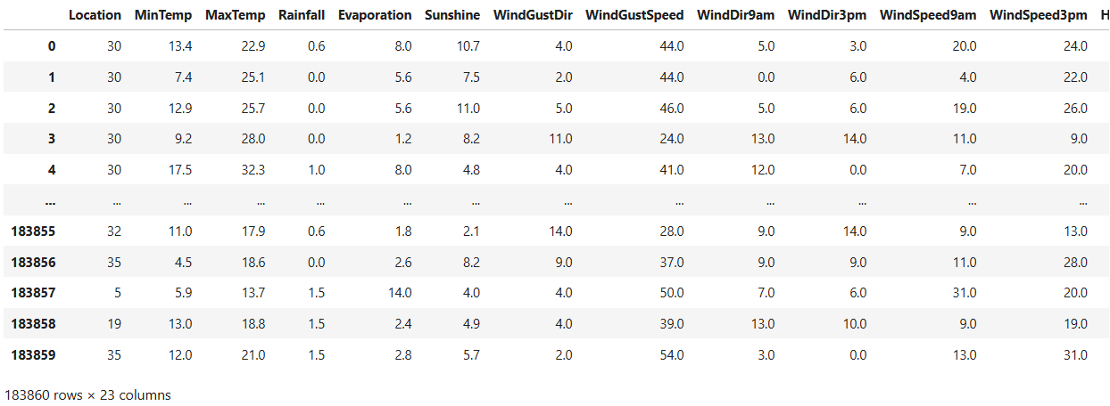
feature_selection :-

Slide 47
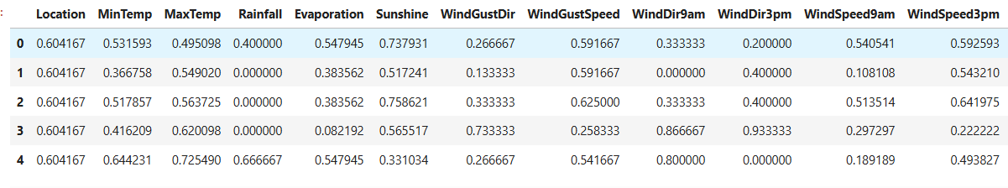
Preprocessing:-

